Slide 1

What are the benefits of Geotechnical Data Interchange?
Scott L. Deaton, Ph.D.
Dataforensics

Slide 2


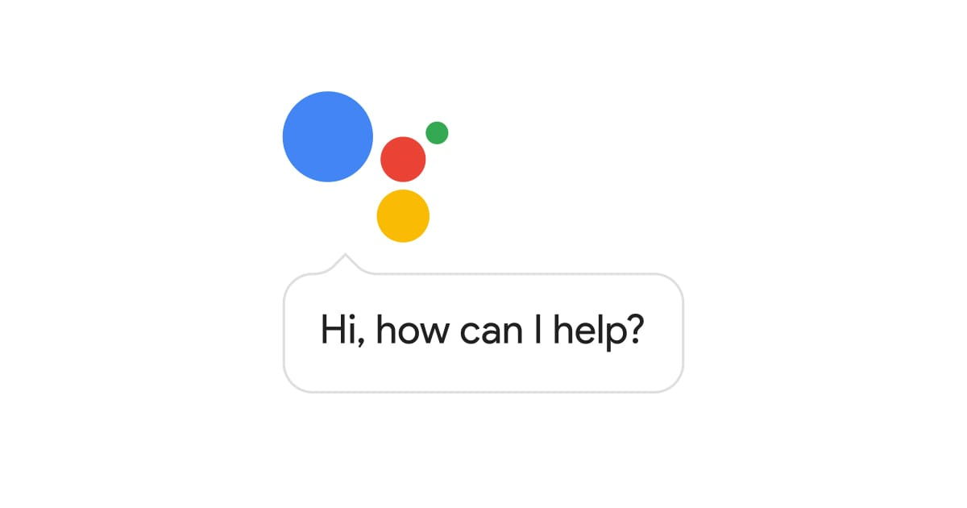

Alexa
Google Assistant
Siri
Cortana
AI
Big Data
Notes:
Technology is changing rapidly to make our lives easier
Technology in geotechnical engineering is also changing rapidly to make our work easier and more reliable. Work smarter – not harder.

Slide 3
Challenge 1 What is Geotechnical Data?

Slide 4
Geotechnical Data
“facts or figures obtained from all phases of a geotechnical project, including derivations from other data
NOTE Facts and figures might include text, numbers and formulae.”
Source: BS 8574:2014 Code of practice for the management of geotechnical data for ground engineering projects

Slide 5
Data or Information
If you can process it into one or more formats
without re-inputting it
or
without using multiple cut and paste operations
You have data

Slide 6
Data or Information
If not …
You have information

Slide 7

Quiz - Have you been given Information or Data?

Slide 8
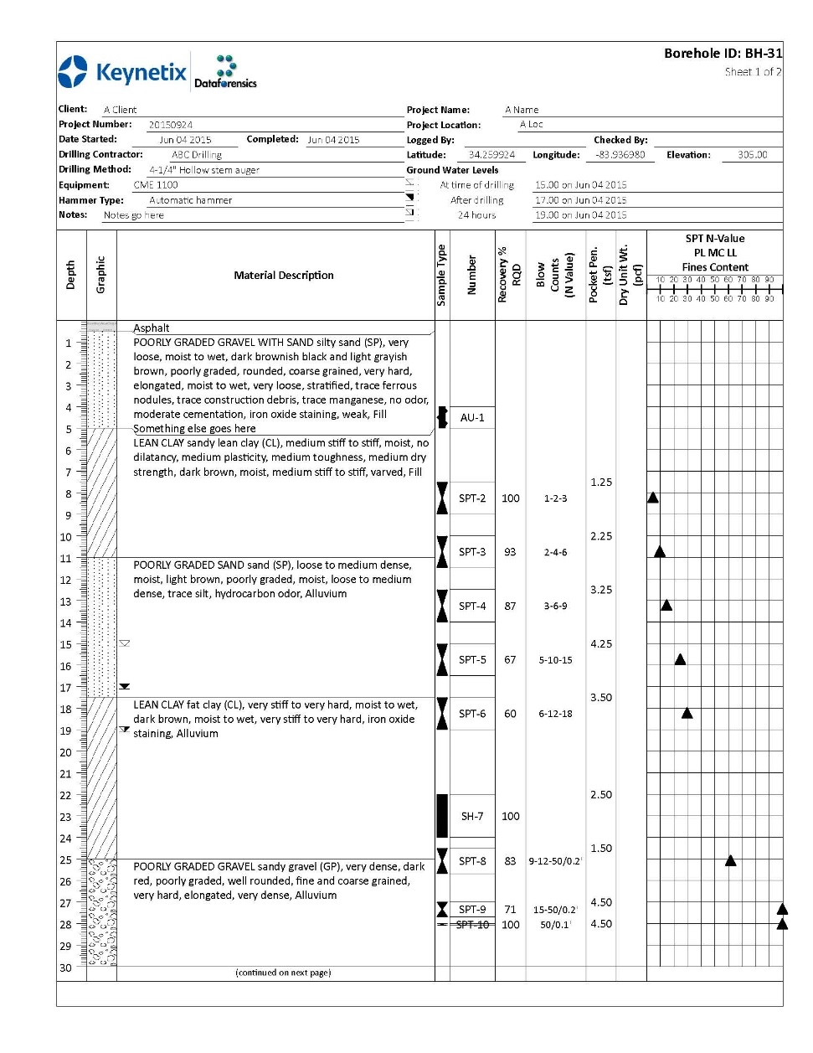
Data or Information?
PDF borehole log

Slide 9
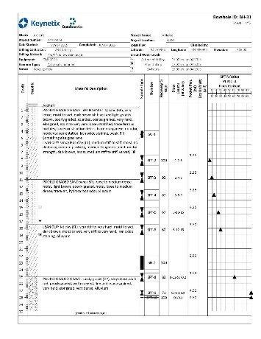
You have Information

Slide 10
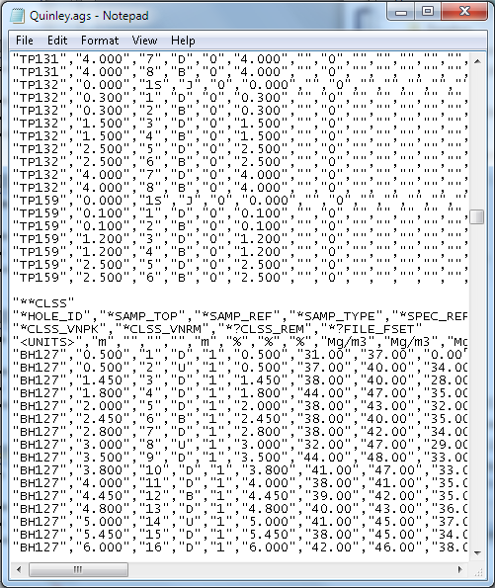
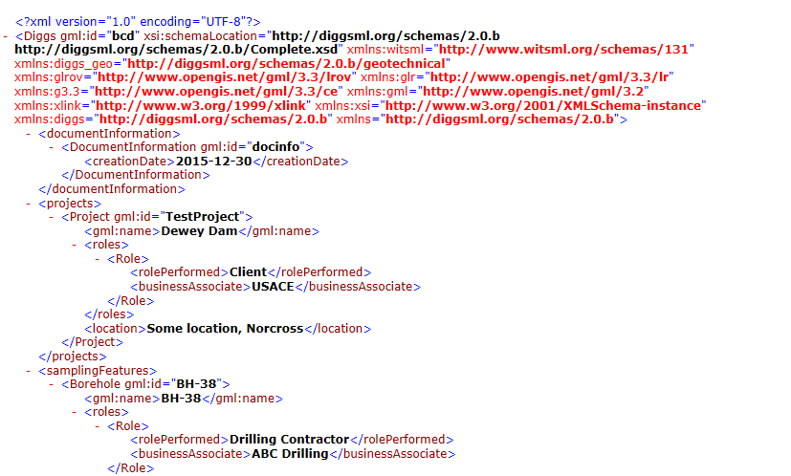
Data or Information?
An AGS data file
A DIGGS data file

Slide 11

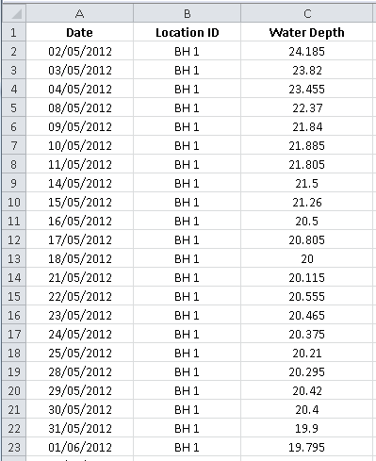
You have Data!

Slide 12
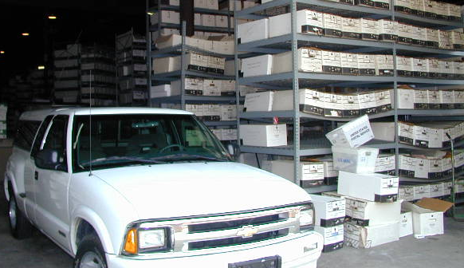
Not Data
PDF borehole logs
(Not Data)

Slide 13
Overview
Dataforensics hired by Ohio DOT to review OGE internal processes and consultant processes
Goals:
Review and provide recommendations for how to improve OGE processes
Identify where DIGGS fits into the OGE processes and consultants processes

Slide 14
Why do we care about data?
How would you feel if you were told to re-type the N-Value for a single borehole 10 times?
How reliable would that data be?

Slide 15
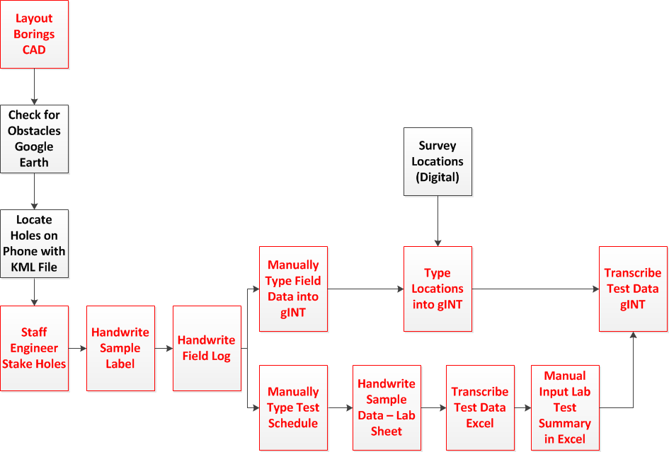
Typical Consultant Workflow
1
5
7
11
3
4
2
6
8
9
10

Slide 16
Three Golden Rules for Data Entry
1
Only do it once

Slide 17
Three Golden Rules for Data Entry
2
Get someone else
to do it

Slide 18
Three Golden Rules for Data Entry
3
Do NOT put multiple pieces of DATA in the same field

Slide 19









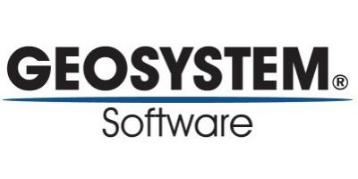


Data Interchange Standards
Allows Data Producers to optimize their processes
Use software that best fits their needs
Allows Data Consumers to utilize data
Use software that best fits their needs

Slide 20



DIGGS

Slide 21
Geotechnical Data Producers
Field Personnel
Lab Personnel
Design Personnel
No software fits the needs of all consumers
Software must communicate data

Slide 22
Geotechnical Data Consumers
Consultants (for historical projects or teaming projects)
Clients (DOT’s, USACE, large commercial/industrial clients)
Contractors
Different departments (e.g. within a DOT – pavement design, bridge design, culvert design, etc)
Notes:
No software fits the needs of all consumers
Software must communicate data

Slide 23
Regional Archive
5
4
3
Engineer
Client
2
1
Drilling Rig/Crew
Lab
5 stages of data transfer
Notes:
Each project has different partners who produce or use the data.
Agreed ways of transferring this data between partners has to be agreed
Partners can be internal or external (departments or companies)
If we have different ways of transferring data for each blank line then this project has 6 standards to agree to be efficient.
This is only a small project.

Slide 24
Client
Engineer
Engineer
Engineer
Drilling Rig/Crew
Lab
Drilling Rig/Crew
Lab
Drilling Rig/Crew
Lab
Drilling Rig/Crew
Lab
Drilling Rig/Crew
Lab
Drilling Rig/Crew
Lab
15 stages of data transfer
Notes:
Each project has different partners who produce or use the data.
Agreed ways of transferring this data between partners has to be agreed
Partners can be internal or external (departments or companies)
If we have different ways of transferring data for each blank line then this project has 6 standards to agree to be efficient.
This is only a small project.

Slide 25

Streamline Internal Processes
Boring Log Software
Onsite Logging Tablet
Data Analysis Software
Laboratory Management Software
CAD Software
GIS Software

Slide 26
Benefits for Consultants
Enables consultants to get DATA from clients (DOT’s, USACE, teaming partners)
Use data without re-inputting it – reduces costs!
Eliminate redundant data entry internally
Fewer errors and reduces cost of internal processes
Optimize your internal process for producing data
Don’t need to have a different process for each client/owner
More efficient, more reliable data, lower risk
Do more design instead of data manipulation

Slide 27
Benefits for Owners
More reliable data provided to owners
Enables contractors to use DATA
Optimize construction, reduce risk, safer/more reliable
Eliminate redundant data entry internally
Fewer errors and reduces cost of internal processes
Optimize your internal process for producing data and sharing data among data consumers
Reduce software integration costs

Slide 28
Status of DIGGS
DIGGS version 2.5 released in 2018
Dataforensics has tested this extensively with ODOT’s data
ODOT has tested this extensively with ODOT data and consultants data
Dataforensics has tested this extensively with CPT data

Slide 29
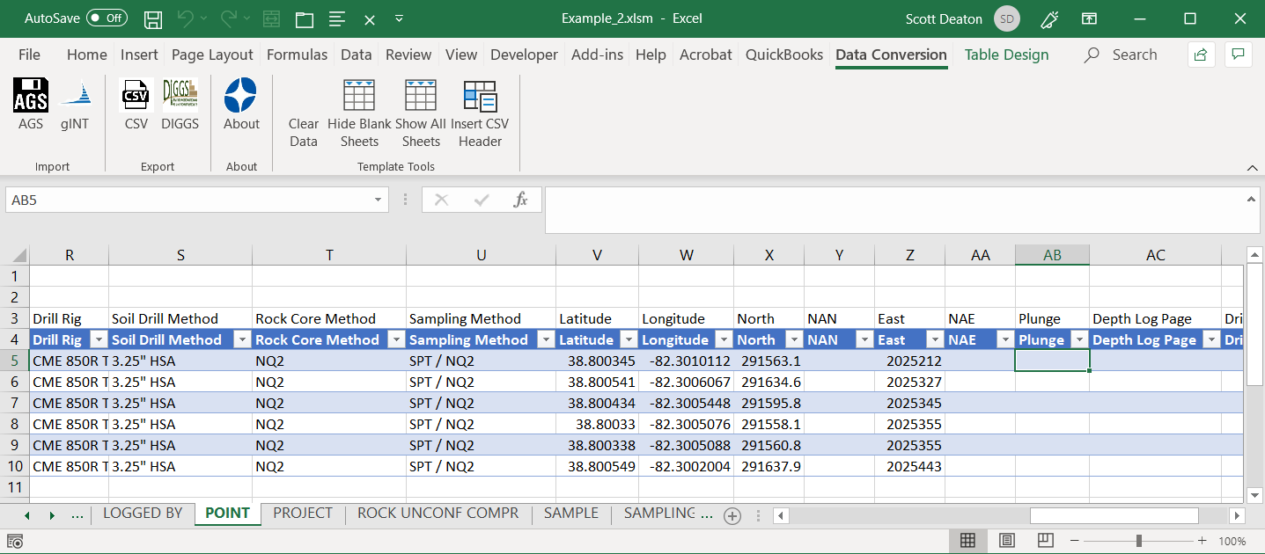
Keynetix DIGGS Conversion Tool
Create DIGGS files from Excel, gINT, AGS, HoleBASE

Slide 30
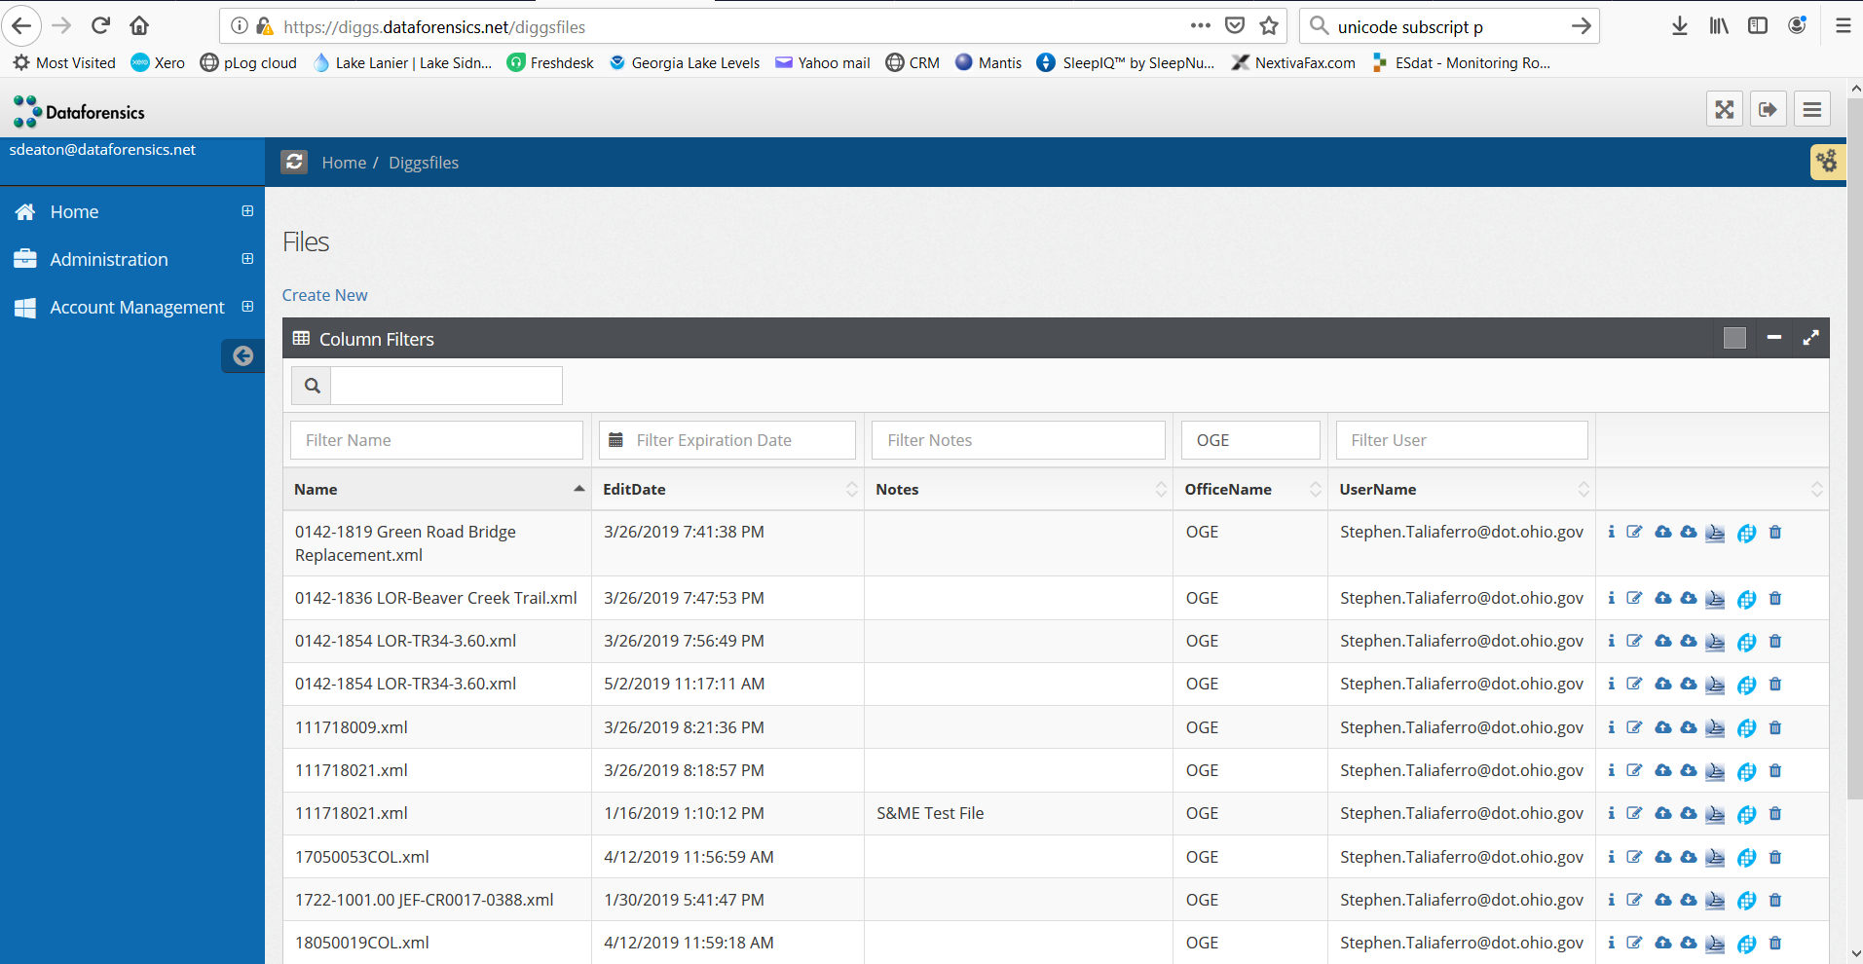
Dataforensics DIGGS Conversion Tool

Slide 31
DIGGS Status
Conetec is able to generate DIGGS files natively (CPT)
FHWA has a project with WSP to develop a web-based tool for generating DIGGS data.
Various other DOT’s and USACE are actively looking at requiring DIGGS

Slide 32
How Can I Begin Using DIGGS?
To generate DIGGS data automatically:
You need an export mapping to export from your data structure to DIGGS
To import DIGGS data automatically:
You need an import mapping to import from DIGGS to your data structure
For more information talk to me here at the conference or email me at sdeaton@Dataforensics.net

Slide 33
Data Management Maturity Model
Pareek, D. (2007) “Business Intelligence for Telecommunications”
AI

Slide 34
Thank you to all the assistance provided by all Ohio DOT OGE personnel involved in the review process. Special recognition is afforded to Chris Merklin, Steve Taliaferro and Paul Painter who have been instrumental in this review process

